Slide 1

Pre-commit hooks
Steven Black
sr DevOps Engineer
The [missing] element needed for achieving pristine Terraform code
Notes:
Hello! I’m Steven Black, senior DevOps engineer at Rhythmictech.
I’m here to talk to you about terraform-specific pre-commit hooks.
Please stop me if you have any questions.
I will quickly go through what
A git workflow with an eye at the pre-commit hook
The pre-commit framework
A short demo

Slide 2

Image of Fur-Baby, per custom

Slide 3
A bit of background on Git
A bit of background on the pre-commit hook library
A demo

Slide 4


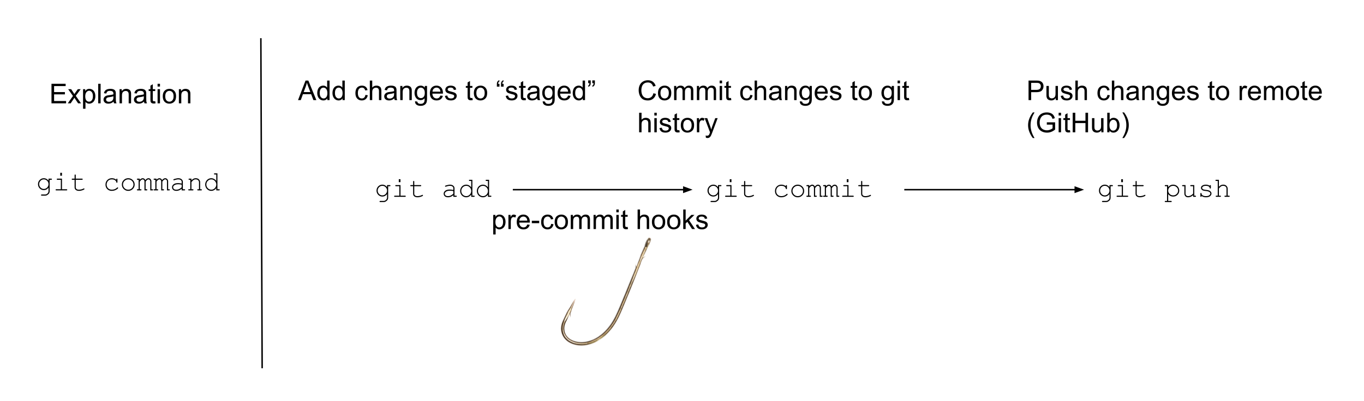
Pre-commit hooks
Creating documentation with terraform-docs
Security scanning with tfsec
Terraform linting with tflint
Notes:
Here’s a git workflow, diagramed with a simple explanation above a git command.
In between an engineer working on terraform and it arriving on GitHub there are a few steps.
First, you “add” the changes (or new file) to git. Git hasn’t saved it yet though, you’ve just pointed it out to git.
Then, you “commit” the changes to your git history. This saves is in git’s database.
Finally, you “push” the code where it goes to GitHub!
When you try to commit code git will run the “pre-commit hook”, which is a reference to the “hook” design pattern.
It means that git gives us a way to call external programs before it will execute a commit. These programs can do cool things like automatically generate documentation, perform security scans, and lint for best practices.

Slide 5


Pre-commit framework
What is pre-commit, the framework?
pre-commit is like a package manager for scripts that run in git hooks
What is a package manager?
What? Why?
The moniker pre-commit refers to hooks that run before you commit changes to git but there are other hooks. By using the pre-commit hooks we’re able to ensure our code is quality before we commit it to our git histories or push it up to GitHub. This helps us avoid the nasty booboo of pushing code up to GitHub and waiting for someone else to figure out why it doesn’t work as expected.
Notes:
I mentioned that pre-commit is the name of a hook and a framework. The pre-commit framework is just a package manager for pre-commit scripts.
What is a package manager? It’s like the app store – an application you use to download and install other applications.

Slide 6
terraform-docs bc pretty docs are life
tfsec bc security is sexy
tflint bc “best practices” are de best
terraform fmt bc obviously
GitHub Actions to publicly shame those who don’t conform

Slide 7


Demo
Run the hooks
Add a bug
Saved by the hooks
Fix it

Slide 8




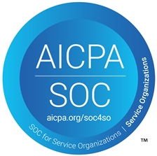


Thank You
Connect with Us!
www.rhythmicTech.com
Github: rhythmictech
Twitter: RhythmicTech
Linked In: Rhythmic Technologies
The Cloud. Done Right.
Notes:
Anyone object to me adding you to our newsletter.
CTO’s and CIOS’

